Slide 1


Concrete Syntax for a UML Action Language
Joint Revised Submission of the
Action Language for Foundational UML (Alf)

Slide 2







Submitters and Supporters
Model Driven Solutions
Mentor Graphics
88solutions Corporation
No Magic
Visumpoint
International Business Machines
Ericsson (supporter)
CEA (supporter)

Slide 3
Agenda
Purpose and Scope
Design Principles
Examples
Changes Since Initial Submission
Need for a Second Revised Submission
Completion Plan

Slide 4
Purpose and Scope
From the RFP:
“This request therefore solicits proposals for a concrete syntax for a textual UML Action Language for the action model incorporated into fUML that will operate only at the level of abstraction of UML and which is capable of being translated into different implementations for different platforms and languages.”
“The scope of the action language is the action model of the Executable UML Foundation, including the standard model libraries for I/O and basic operations.”
“Proposals may incorporate constructs for other elements in the Executable UML Foundation that are not part of the action model, if desired.”

Slide 5
Design Principles
Provide a familiar C-legacy (“Java like”) syntax, but allow UML textual syntax when it exists .
Minimize the need for graphical models to change in order to accommodate use of the action language.
Be usable in the context of models not limited to the fUML subset.
Provide a naming system that is based on UML namespaces for referencing elements outside of an activity and a consistent use of names to reference nodes within an activity.
Allow for both explicit type declaration as well as an implicit type system based on typing declared in the structural model elements.
Provide a notation to take advantage of the underlying flow-oriented nature of activity models, with an expressivity similar to the OCL notation for collections. (optional)
Provide a concrete syntax for structural modeling (largely within the bounds of the fUML subset). (optional)

Slide 6
Example: Summing a List (from RFP)
Presuming the use of a linked list
nextCall = callList.head;
totalTime = 0;
while (nextCall != null) {
totalTime += nextCall.minutes;
nextCall = nextCall.next
}
But UML doesn’t specify linked lists; it’s an implementation choice. What happens when the data structure changes? Much of this logic must be modified.
Alf notation at minimum conformance level

Slide 7
Example: Summing a List (continued)
Iteration without presuming a list data structure
totalTime = 0;
for (time in Call.allInstances().minutes) {
totalTime += time;
}
Reduction without explicit iteration
totalTime = Call.allInstance().minutes->reduce '+';
[ Previous notation:
totalTime = #'+'(Call.allInstance().minutes); ]
Alf notation at minimum conformance level
Alf notation at full conformance level

Slide 8
Example: Quicksort
Functional definition
activity Quicksort(in list: Integer[0..*] ordered): Integer[0..*] ordered
{
if (list->isEmpty()) {
return null;
} else {
x = list[1];
return QuickSort(list->select a (a < x))->
including(x)->
union(QuickSort(list->select b (b >= x));
}
}
Alf notation at full conformance level
(other than surrounding activity definition)

Slide 9
Example: Quicksort (continued)
"In-place" definition
activity QuicksortInPlace
(inout list: Integer[0..*] ordered, in low: Integer, in high: Integer)
{
if (low < high) {
l = low;
h = high;
p = list[high];
do {
while ((l < h) && (list[l] <= p)) {
l = l+1;
}
while ((h > l) && (list[h] >= p)) {
h = h-1;
}
if (l < h) {
t = list[l];
list[l] = list[h];
list[h] = t;
}
} while (l < h);
t = list[l];
list[l] = list[high];
list[high] = t;
QuicksortInPlace(list, low, l-1);
QuicksortInPlace(list, l+1, high);
}
}
Alf notation at minimum conformance level
(other than surrounding activity declaration)

Slide 10
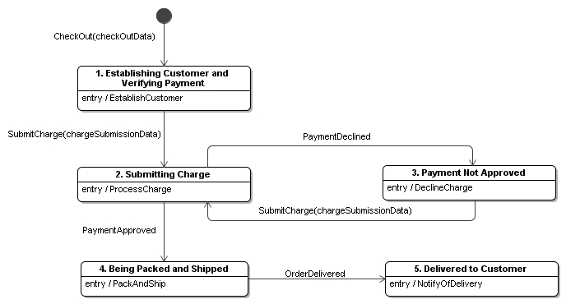
Example: Online Order
R10.createLink(this, this.checkOutData.cart);
matchingCustomers = Customer -> select c
(c.email == this.checkOutData.customerEmail);
if (matchingCustomers->isEmpty()) {
customer = new Customer(this.checkOutData);
} else {
customer = matchingCustomers[1];
customer.update(this.checkOutData);
}
R5.createLink(this, customer);
this.dateOrderPlaced = TimeUtility::GetDate();
this.SubmitCharge
(new ChargeSubmissionData(this.checkOutData));
Opaque Behavior

Slide 11
Example: Online Order Class – Extended Alf
namespace Ordering;
private import DomainTypes::*;
private import TimeUtility::*;
active class Order
{
public orderID: ArbitraryId;
public dateOrderPlaced: Date;
public totalValue: Money;
public recipient: PersonalName;
public deliveryAddress: MailingAddress;
public contactPhone: TelephoneNumber;
private checkOutData: CheckOutData;
private chargeSubmissionData: ChargeSubmissionData;
public datatype CheckOutData;
public datatype ChargeSubmissionData;
public receive signal CheckOut { public data: CheckOutData; }
public receive signal SubmitCharge { public data: ChargeSubmissionData; }
public receive signal PaymentDeclined{ }
public receive signal PaymentApproved{ }
public receive signal OrderDelivered { }
private establishCustomer();
private processCharge();
private declineCharge();
private packAndShip();
private notifyOfDelivery();
} do
…

Slide 12
Example: Online Order Class (continued)
{
/** 1. Establishing Customer and Verifying Payment */
accept (checkOut: CheckOut);
this.checkOutData = checkOut.data;
this.establishCustomer();
do {
/** 2. Submitting Charge */
accept (chargeSubmission: SubmitCharge);
this.chargeSubmissionData = chargeSubmission.data;
this.processCharge();
accept (PaymentDeclined) {
declined = true;
/** 3. Payment Not Approved */
this.declineCharge();
} or accept (PaymentApproved) {
declined = false;
}
} while (declined);
/** 4. Being Packed and Shipped */
this.packAndShip();
/** 5. Delivered to Customer */
accept(OrderDelivery);
this.notifyOfDelivery();
}

Slide 13
Changes Since Initial Submission
Merged with IBM UAL submission
  Minimum conformance level has essentially a Java/C conformant syntax…
  …with a few additions for consistency with higher conformance levels (e.g., allowing "::" in qualified names, allowing UML style declarations, "for-in" loops, etc.).
Revised conformance levels
  Minimum – For language snippets including only the capabilities available in a traditional, procedural programming language.
  Full – Complete action language
  Extended – Action language and structural modeling
Re-organized specification
(now emphasizes how Alf can be used within UML models)
  Expressions
  Statements
  Units

Slide 14
Need for Second Revised Submission
Support additional features
  Real/floating numeric types and functions
  Non-base 10 literals and bit manipulation operations
  Static features
  A few additional syntactic changes (link operations, reduction)
Add collection class library
  Provide familiar object-oriented collection abstractions
  Integrate with flow-oriented collection operations
Formalize the specification of the mapping to fUML
  Abstract syntax as the target for parsing of concrete syntax
  Static semantics as derivations and constraints on abstract syntax
  Mapping via QVT transformation from Alf abstract syntax to fUML abstract syntax
Add abrupt transfers of control (exceptions, break, continue)

Slide 15
Completion Plan
Form an Evaluation Working Group
Second revised submission on August 23
Request vote-to-vote in Cambridge, September 20-24
  Then vote on recommendation to adopt

